Slide 1
Big Mountain Resort Analysis

Slide 2
STORY
Big Mountain Resort, the client, is a ski resort located in Montana that offers spectacular views of Glacier National Park and Flathead National Forest, with access to 105 trails that serves about 350,000 people every year. They have recently invested in their facilities which increased their operating costs by $1,540,000 this season.

Slide 3
Problem Statement
Are there any possibilities concerning Big Mountain Resort to create a more efficient pricing strategy that maximally capitalizes on their facilities and offsets their current operating cost?

Slide 4
Current Strategy
Problems
The resort is current pricing strategy is to charge a premium above the average price of Resorts in its market segment.
This strategy does not provide the business with a good sense of the relative importance of their facilities compared to others.

Slide 5
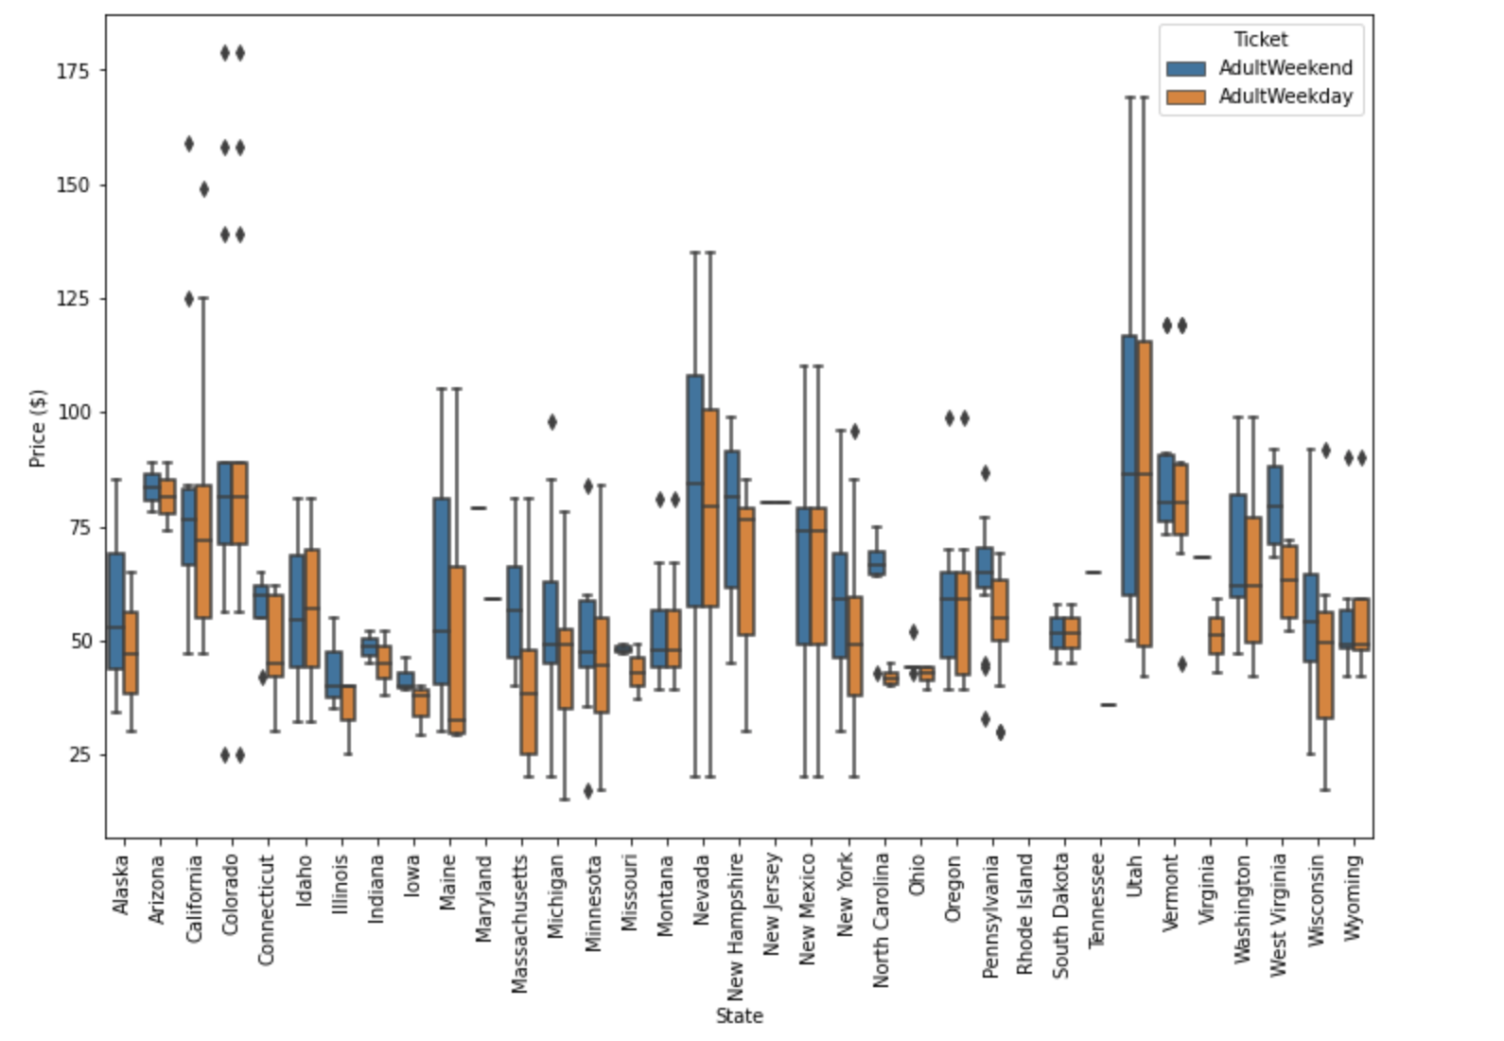
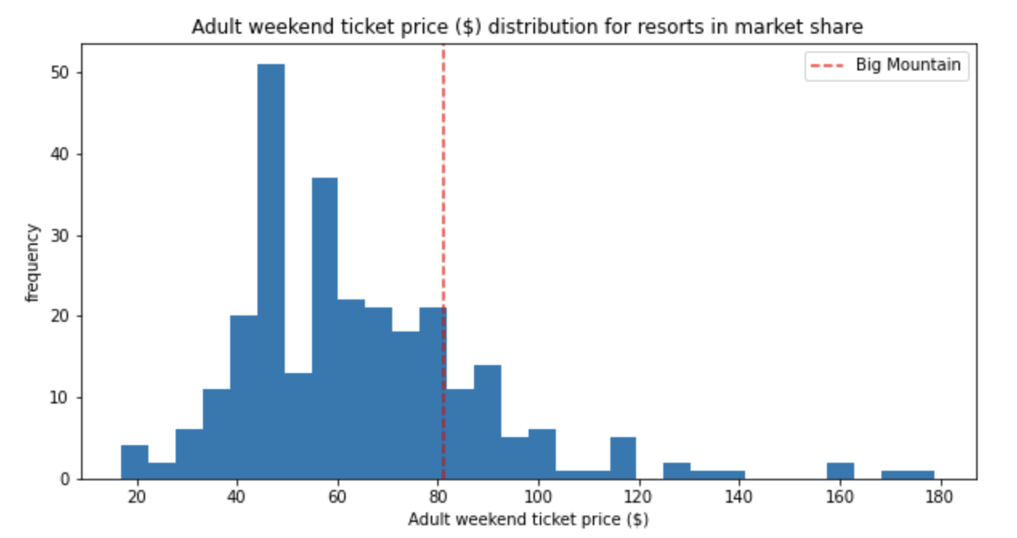
Average Ticket Prices of Resorts

Slide 6
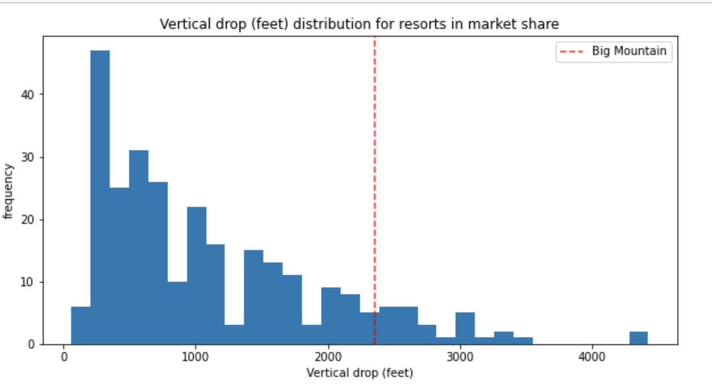
Resorts vertical drop
Big Mountain is doing well for vertical drop but there are still quite a few resorts with a greater drops.

Slide 7
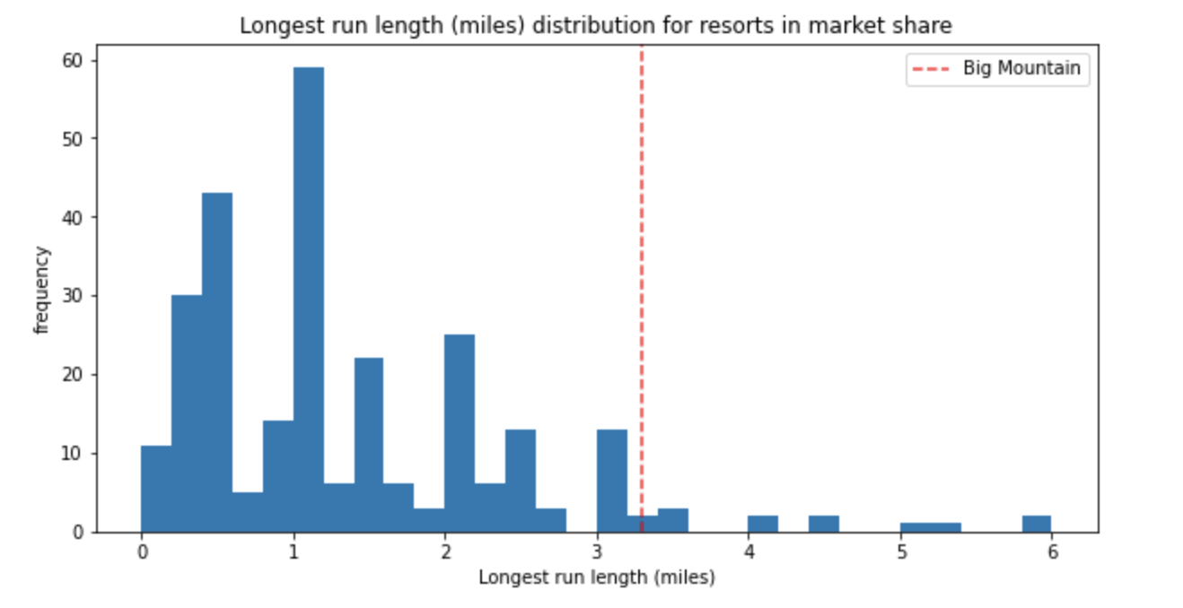
Length of Runs
Big Mountain has one of the longest runs. Although it is just over half the length of the longest, the longer ones are rare.

Slide 8
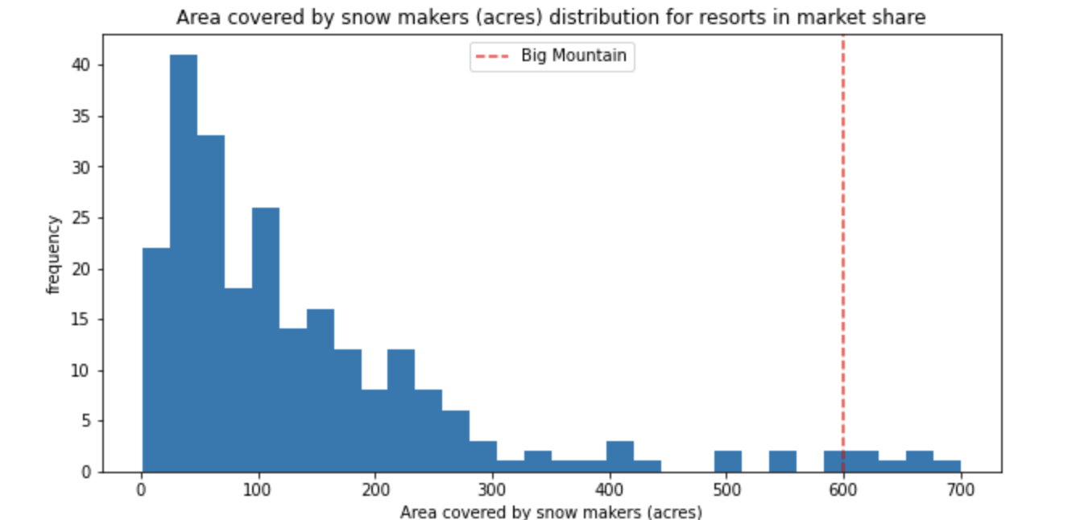
Snow making area
Big Mountain is very high up the league table of snow making area.

Slide 9
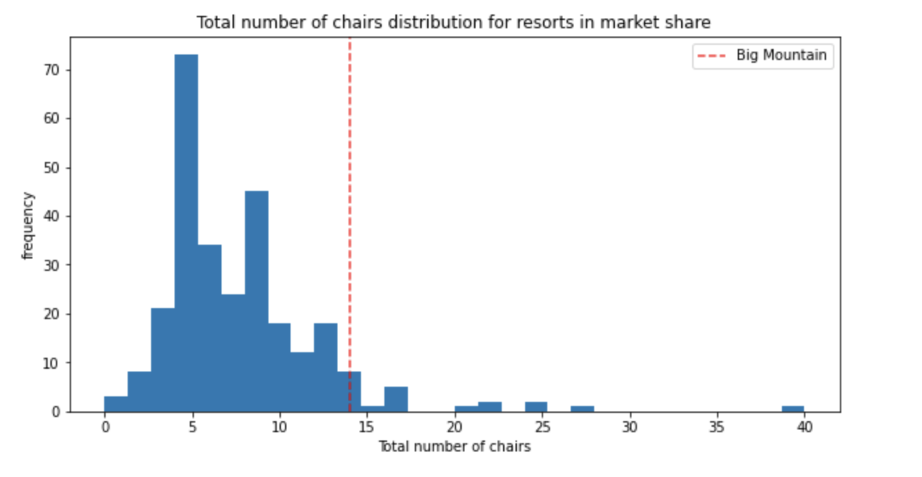
Total number of chairs
Big Mountain has amongst the highest number of total chairs, resorts with more appear to be outliers.

Slide 10
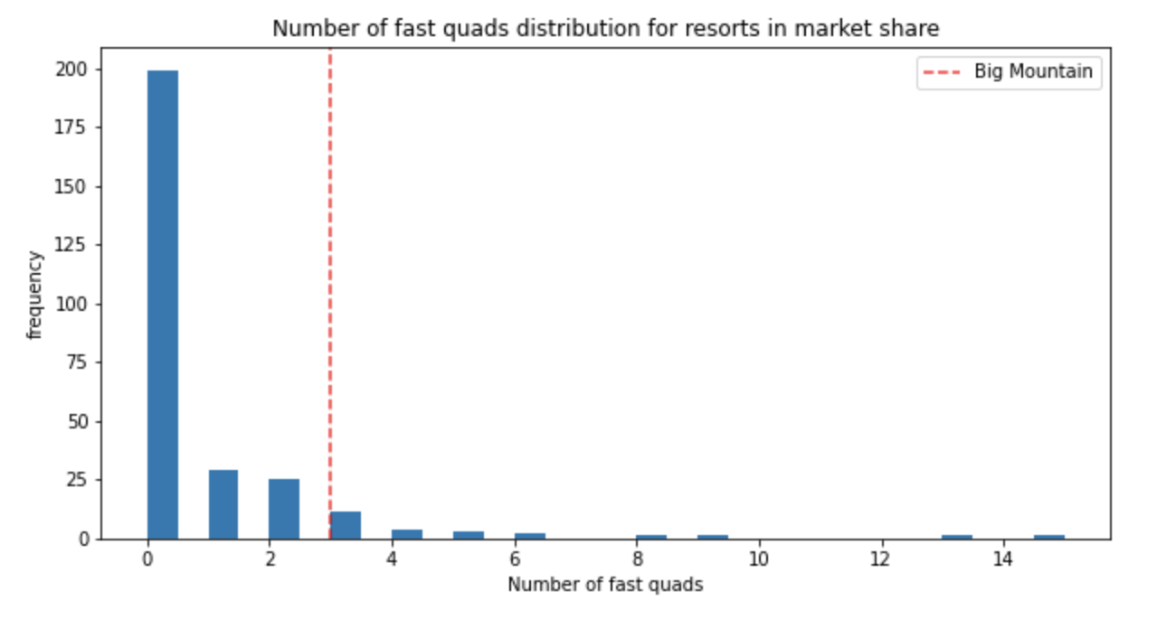
Fast quads
Most resorts have no fast quads. Big Mountain has 3, which puts it high up that league table. There are some values much higher, but they are rare.

Slide 11
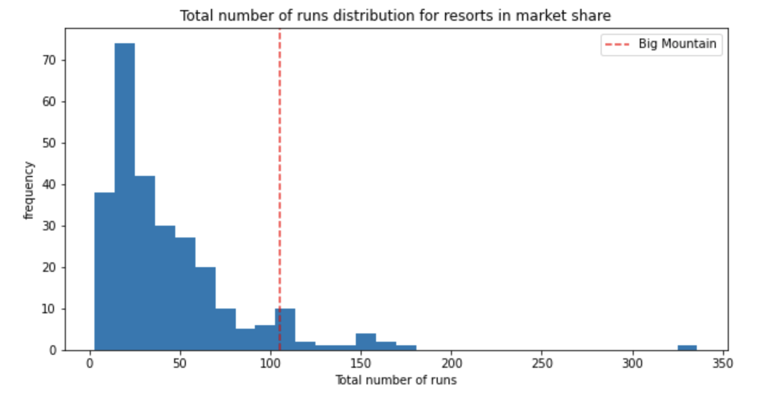
Runs
Big Mountain compares well for the number of runs. There are some resorts with more, but not many.

Slide 12
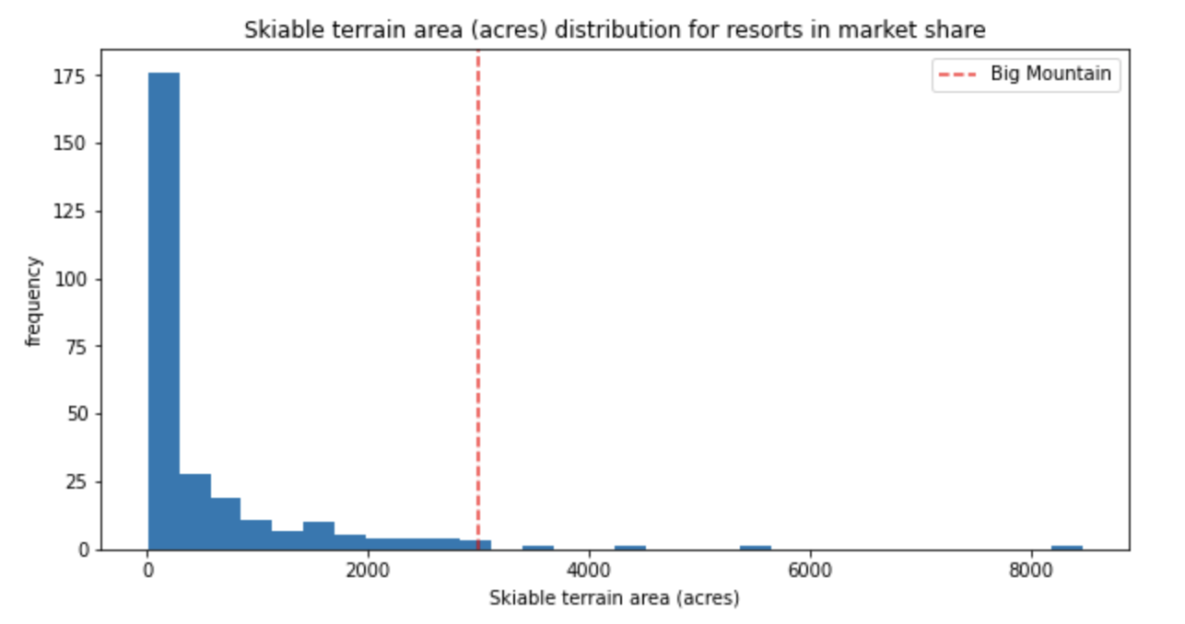
Skiable terrain area
Big Mountain is amongst the resorts with the largest amount of skiable terrain.

Slide 13
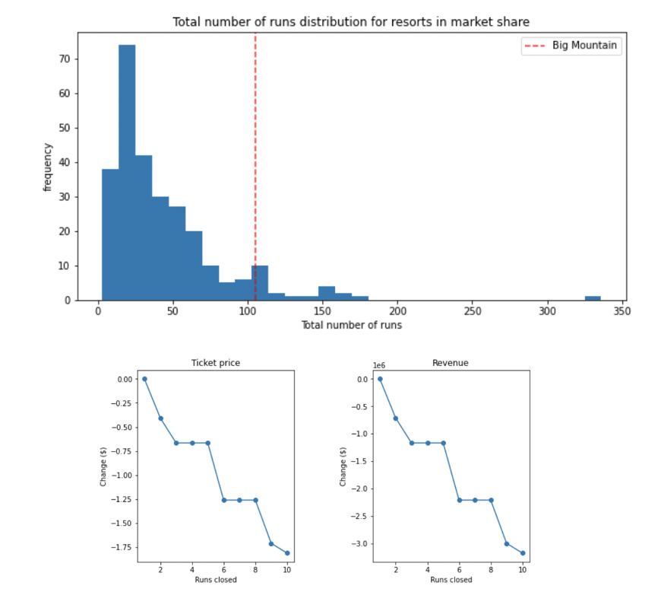
Potential Scenarios
1. Permanently closing down up
to 10 of the least used runs
2. Increasing the vertical drop
3. Same as number 2, but adding 2 acres of snow making cover.
4. Increase the longest run by 0.2 mile to boast 3.5 miles length

Slide 14
Recommendations
The best scenario is to increase the vertical drop by 150 ft, this scenario has increased ticket price by $1.99 from $81 to $82.99, resulting in a bottom-line increase by $1,934,638 (After deducting operating costs = $1.54M).

Slide 15
Main Data Source Limitation
The main data source is missing some important information like:
1. Weekdays ticket price
2. Operating costs for most of the resorts features (e.g., Runs operating cost is missing).
3. exact number of visitors per year
Due to lack of data in regards of operating cost per used run and weekdays ticket price, our model cannot recommend closing down used runs or implementing a dynamic ticket pricing.
Cannot recommend more chairs because the effects may be attributed to exclusive vs. mass market resort effect and the data does not have the number of visitors per year.
In order for our model to provide a better price prediction we need another source of data

